Slide 1
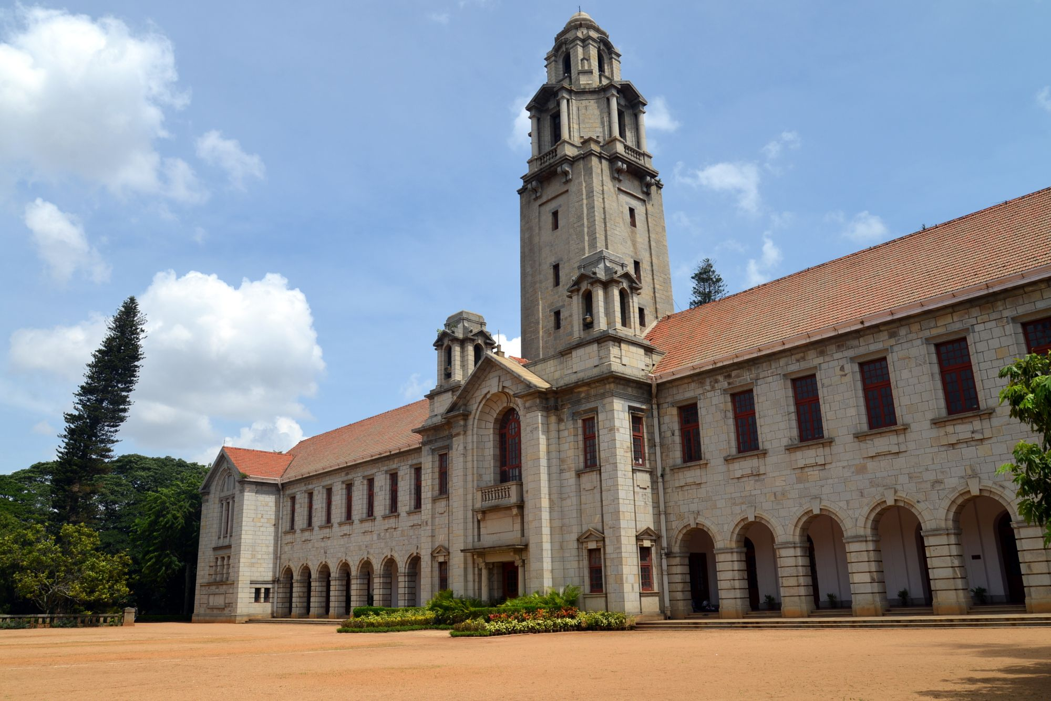
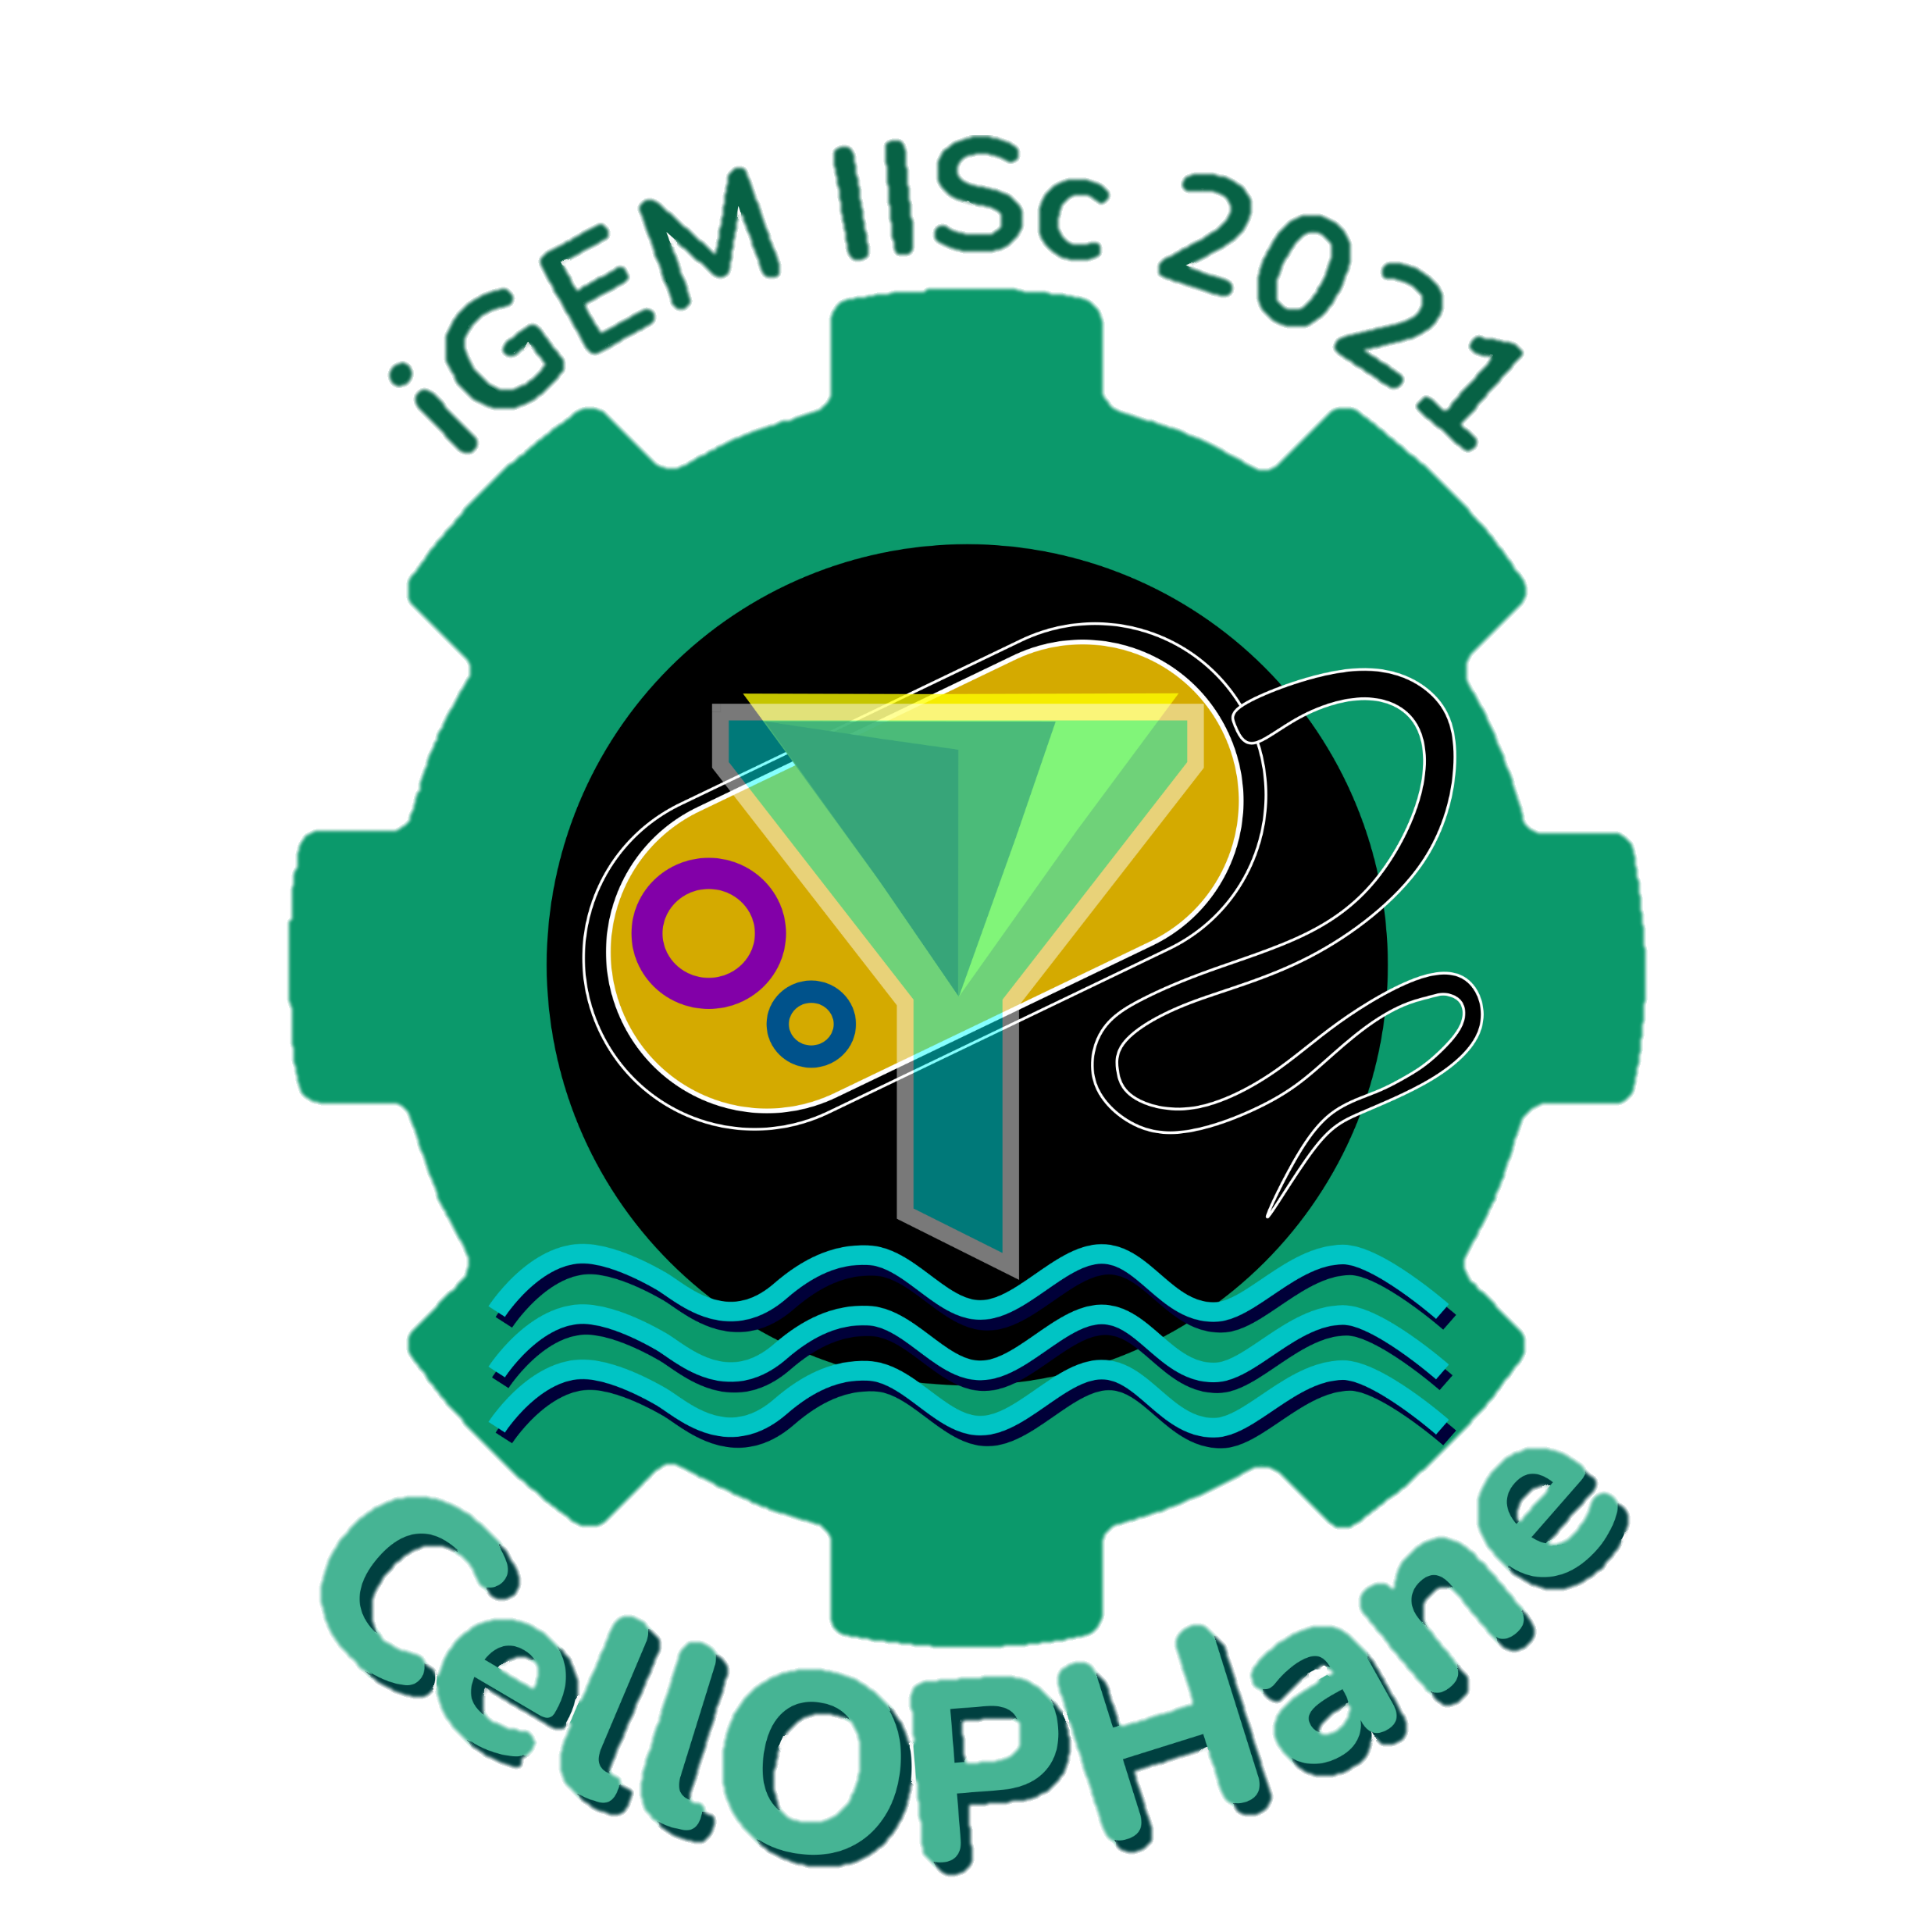


Introduction to Synthetic Biology
by
Team iGEM IISc Bangalore

Slide 2
Modules
What is life? Engineered products vs living organisms
Design Principle behind life
Construction of cells from basic biomolecules
Designing Cells to Obtain Desired Products
Applications of Synthetic Biology in Real Life Problem Solving
Our Project: CellOPHane

Slide 3

Our learning objectives
By the end of these modules, you should have answers to the following questions from the synthetic biology perspective:-
Can scientists design life and make customized living organism to solve global problems?
Can a cell be constructed from scratch using just basic biomolecules?
How can you design cells to make them produce what you want?
How different is a living organism from an engineered product, like radio?

Slide 4
Living organisms vs. engineered products
Are living organisms special? WHICH OF THE FOLLOWING ARE ‘LIVING’?
HUMANS
VIRUSES
ENZYMES
YOUR LIVER
NEURONS
DNA
BACTERIA
WOOD
NOW THINK ABOUT HOW A RADIO IS DIFFERENT FROM THAT OF A LIVING ORGANISMS?

Slide 5
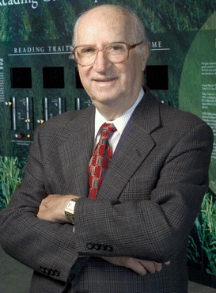
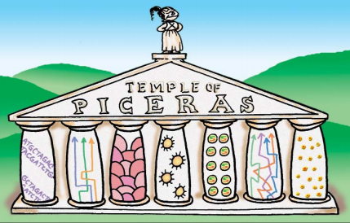
LIFE SCIENCES - BUT WHAT IS LIFE?
“The Seven Pillars of Life” – Dr Daniel Koshland defined life in terms of seven principles called the PICERAS
(SCIENCE, VOL 295, 22 MARCH 2002)
PNAS September 11, 2007 104 (37) 14551-14552; https://doi.org/10.1073/pnas.0707644104

Slide 6
PICERAS
P - PROGRAM
I - IMPROVISATION
C - COMPARTMENTALISATION
E - ENERGY
R - REGENERATION
A - ADAPTABILITY
S - SECLUSION

Slide 7
IT IS NOT ALL BLACK AND WHITE
Alternative definitions of life have also been proposed. NASA’s definition of life, from an astrobiology perspective, is as follows,
‘Self-sustaining chemical system capable of Darwinian evolution’

Slide 8
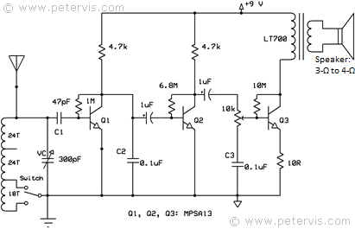
… AND HERE WE GO BACK TO THE RADIO
Signals
x
AUDIO OUTPUT
Y
?...
(Lazebnik, Cancer Cell, SEPTEMBER 2002, VOL. 2)
Credits: https://www.petervis.com/Radios/three-transistor-radio/three-transistor-radio-circuit-diagram.html

Slide 9

Modules
What is life? Engineered products vs living organisms
Design Principle behind life
Construction of cells from basic biomolecules
Designing Cells to Obtain Desired Products
Applications of Synthetic Biology in Real Life Problem Solving
Our Project: CellOPHane

Slide 10
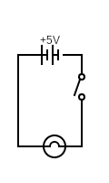
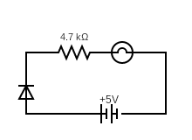
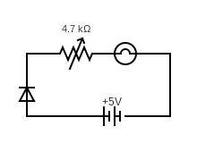
Design? Customise?
The radio is fundamentally a very complex electric circuit. What is it made of?
Can you think of a simpler system? How would you build one?
Bulb
Wire
Battery
Switch
Resistor
Diode
Rheostat

Slide 11
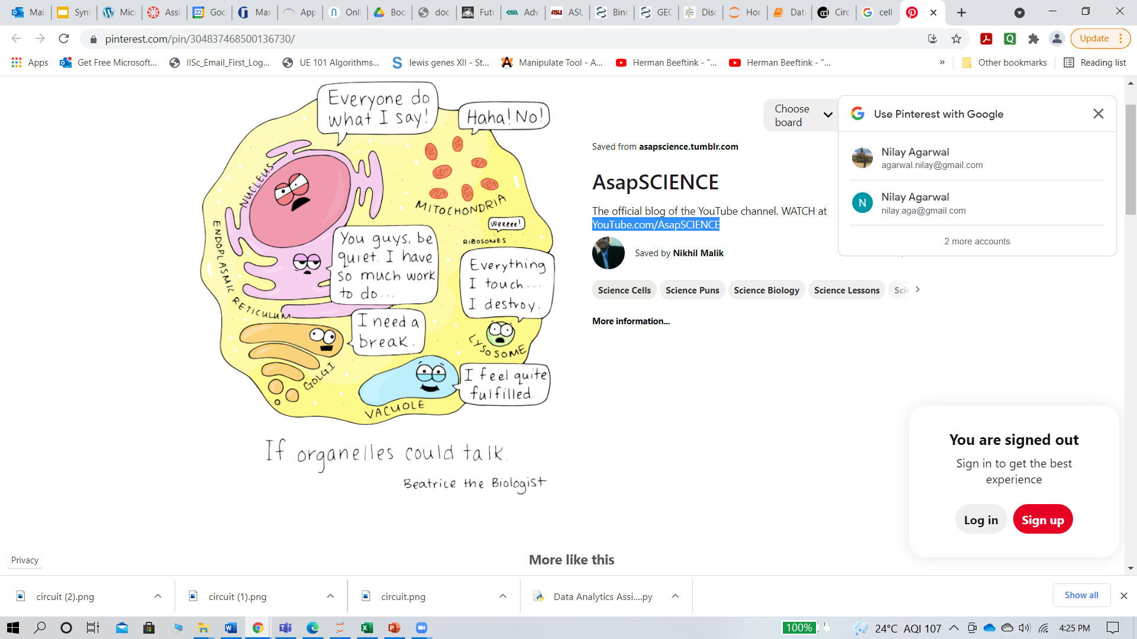
Designing and Customising Cells!
Like a complex circuit can be designed by putting together its components, and customised by Changing them, so can living organisms!
So, what are the components of living systems?
What are the components of cells?

Slide 12
Modules
What is life? Engineered products vs living organisms
Design Principle behind life
Construction of cells from basic biomolecules
Designing Cells to Obtain Desired Products
Applications of Synthetic Biology in Real Life Problem Solving
Our Project: CellOPHane

Slide 13

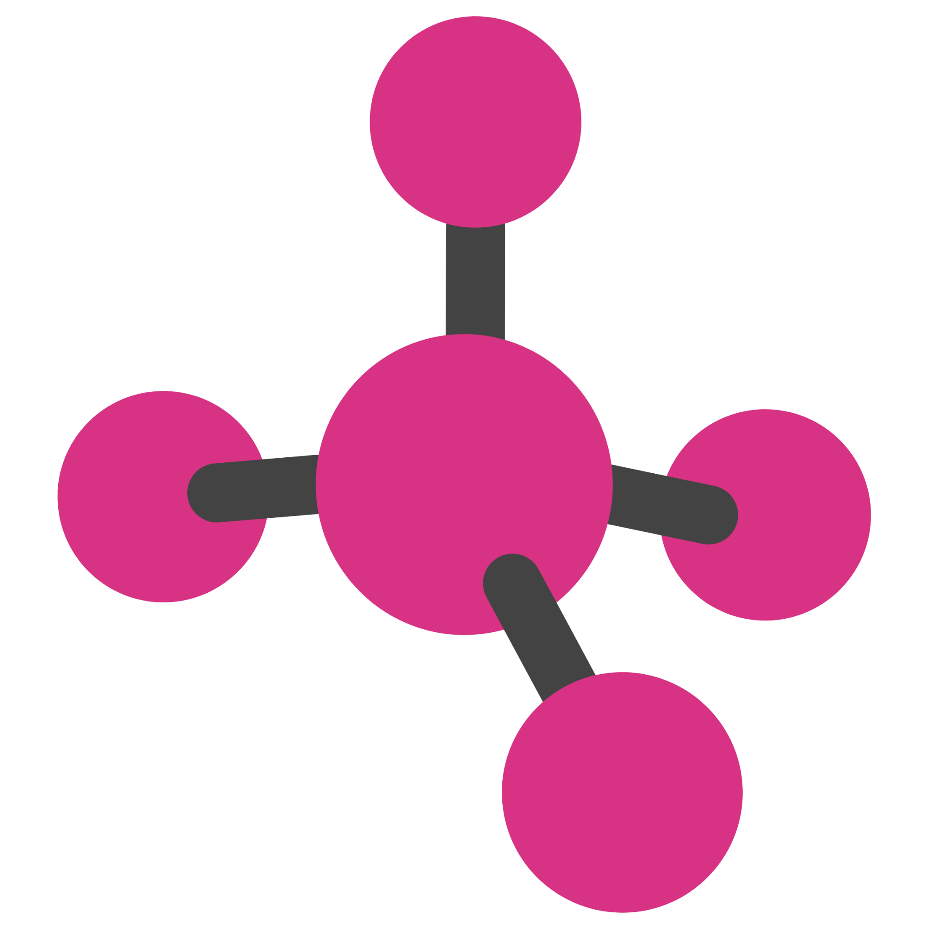
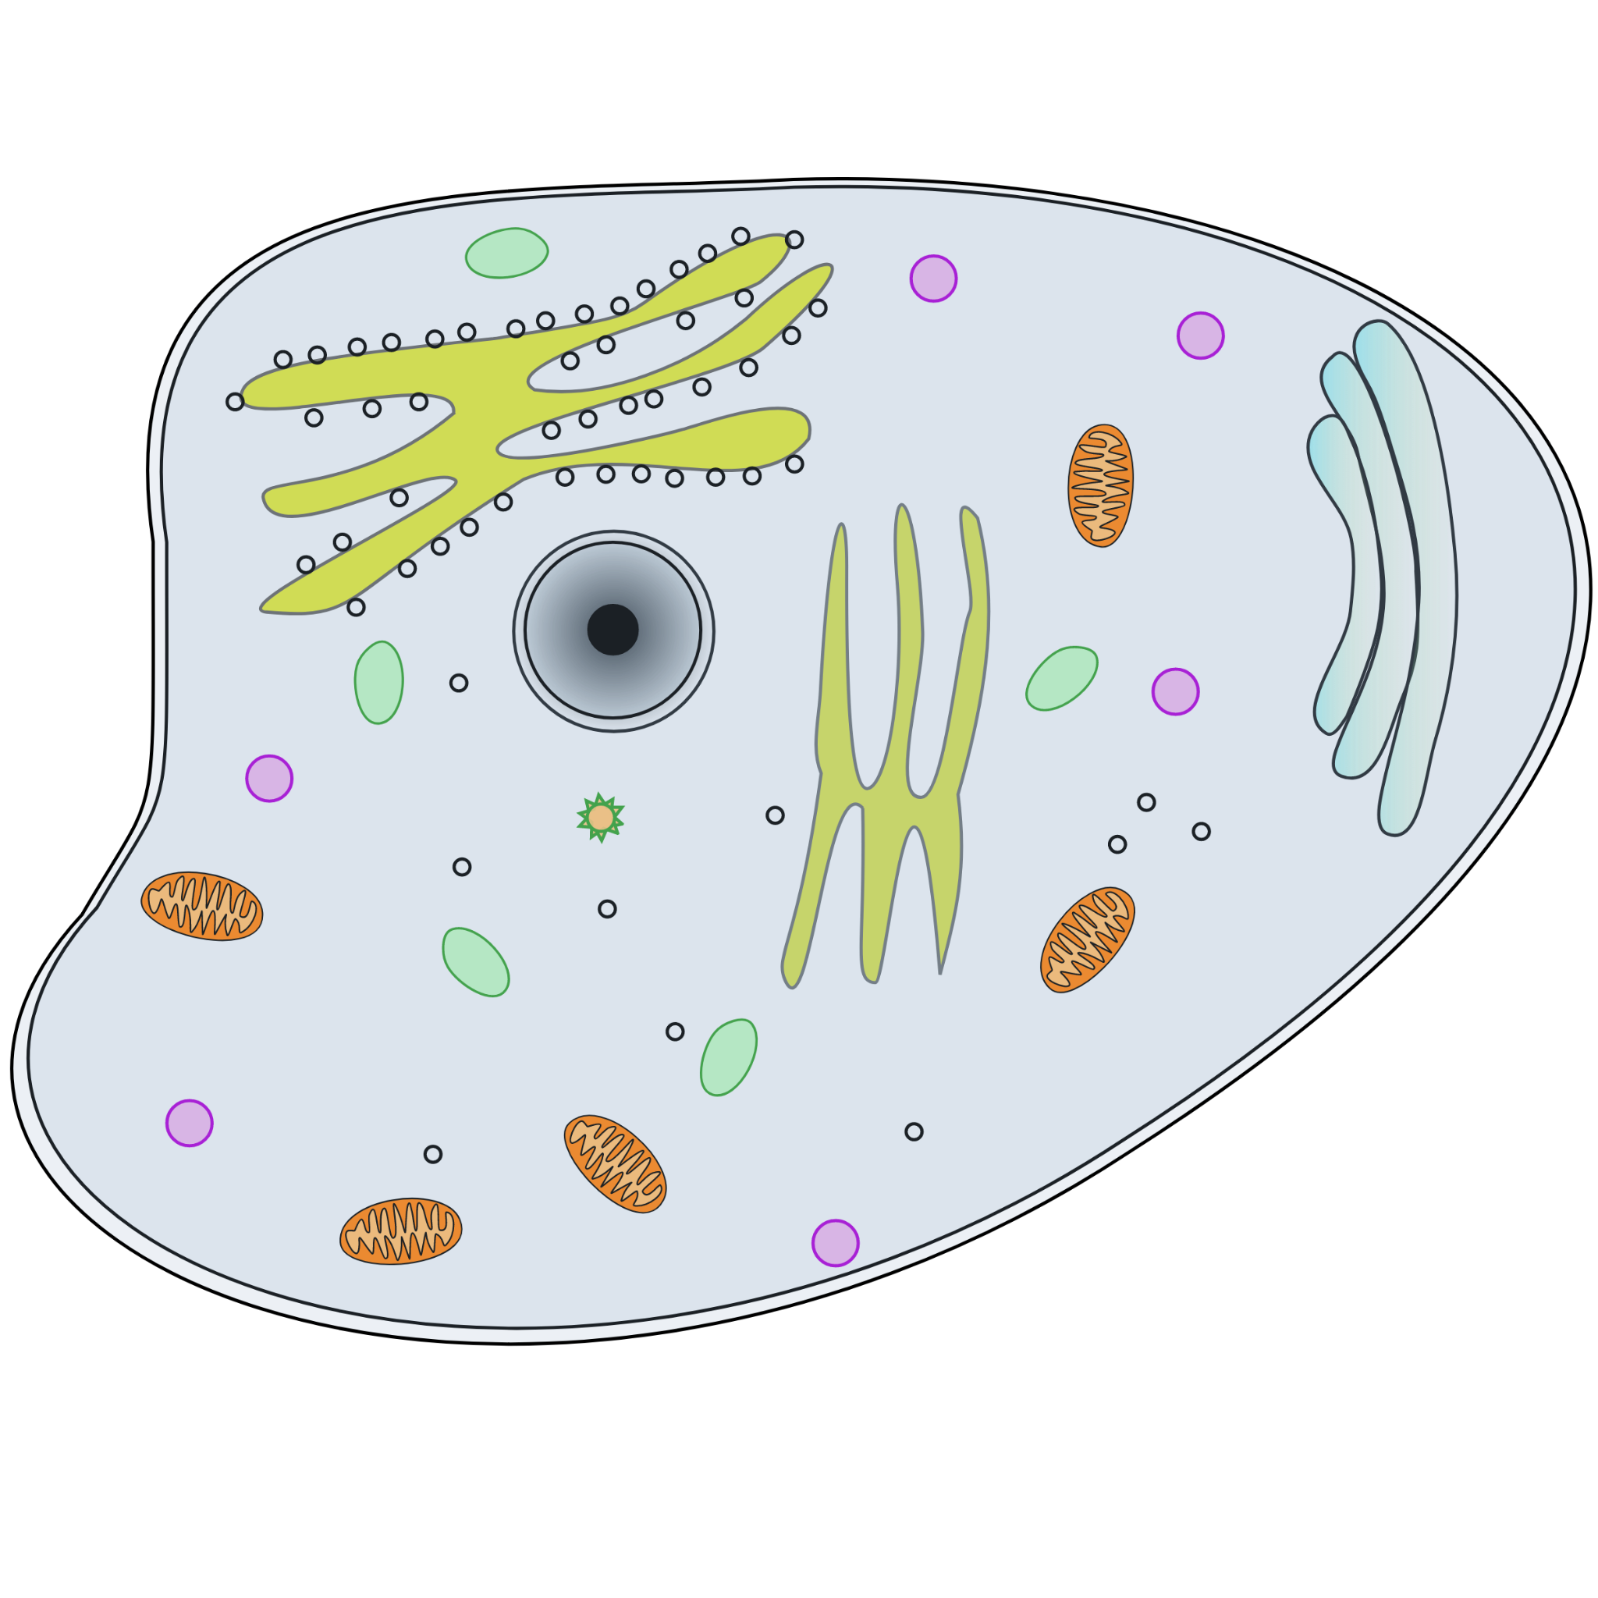

WHAT IS A TYPICAL (“NATURAL”) CELL MADE OF?
Large molecule
Small molecule
Atom
Effectively, the answer is…
BIOMOLECULES!!!
Cell
Cell organelle

Slide 14


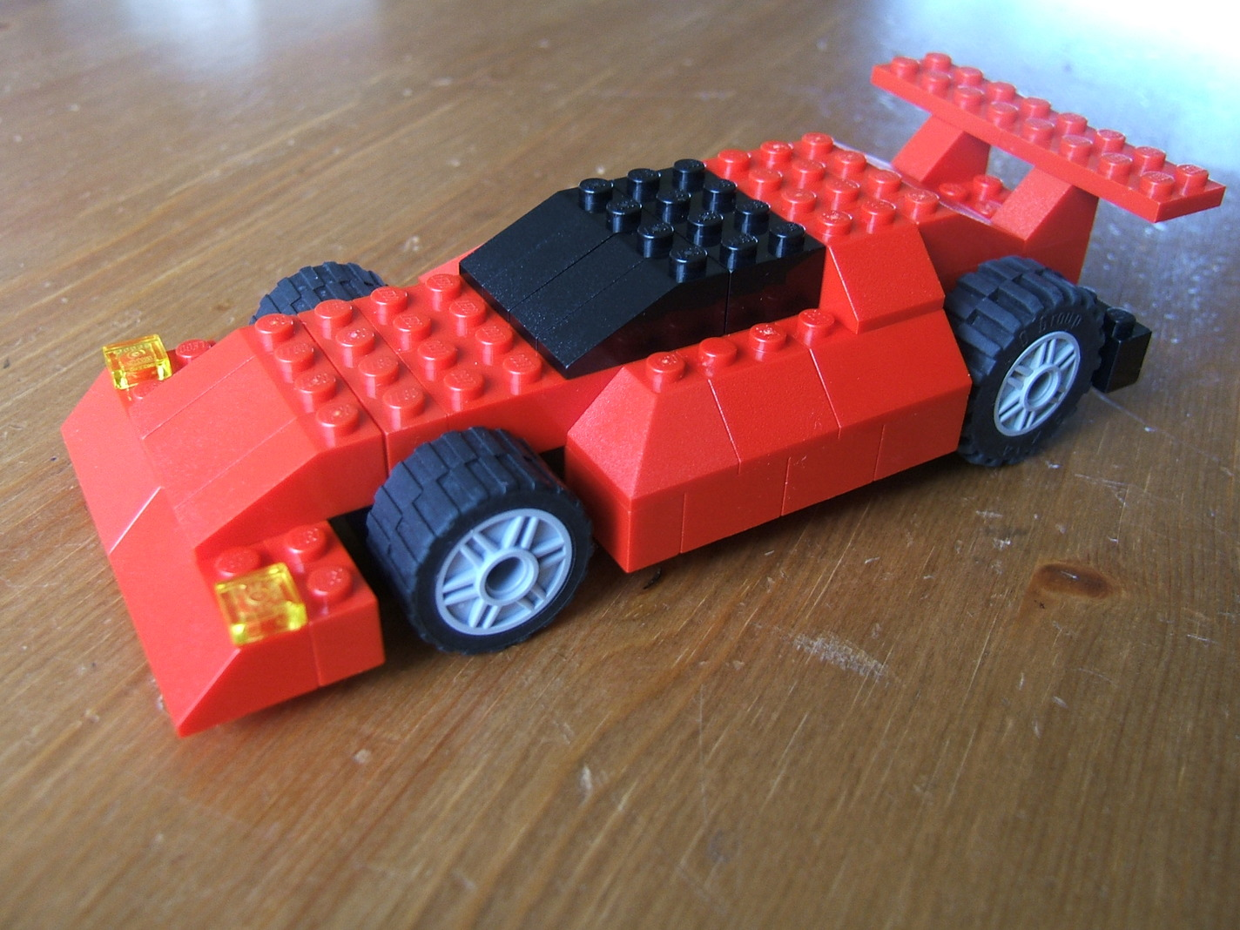
ROADMAPS TO BUILD A CELL WHICH HAS SOME DESIRED PROPERTIES
“Top-down” Approach
Cell
“Bottom-up” Approach
motorward.com
lego-maker.blogspot.com
Take a complex system
Change/modify the component(s) of interest and see how the system responds
Take the essential components
Construct a more complex system bit by bit
Biomolecules

Slide 15
HOW TO BUILD A SYNTHETIC CELL?
WHAT WOULD YOU NEED TO BUILD A SYNTHETIC CELL?
VENTURE YOUR WILDEST GUESSES!

Slide 16



HOW TO BUILD A SYNTHETIC CELL?
static.teteamodeler.com
“Liposome” (body made of fat, a biomolecule) like a Soap Bubble
Nutrient-rich broth
Nutrient rich broth containing DNA
DNA, a wonderful biomolecule, is the blueprint of life!
Much like a remote

Slide 17
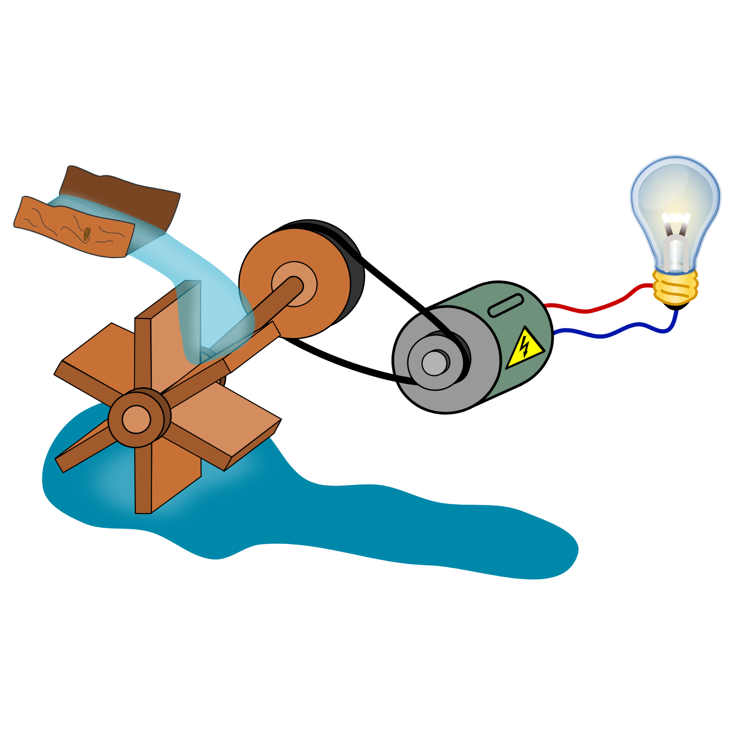

HOW TO BUILD A SYNTHETIC CELL? (CONTD.)
When the cell is supplied with nutrients, this propeller-like protein (another biomolecule) rotates just like a water wheel & generates power to run the cell!

Slide 18


HOW TO BUILD A SYNTHETIC CELL? (CONTD.)
One protein helps in cell division (and thus, in Darwinian evolution);
Another protein aids in communication with outside world.

Slide 19

DREAM OF A SYNTHETIC BIOLOGIST!
Combining only 2-3 of the following bottom-up elements in an artificial cell has been possible:
Enclosure
Broth
Blueprint
Darwinian evolution
Battery
Communication

Slide 20
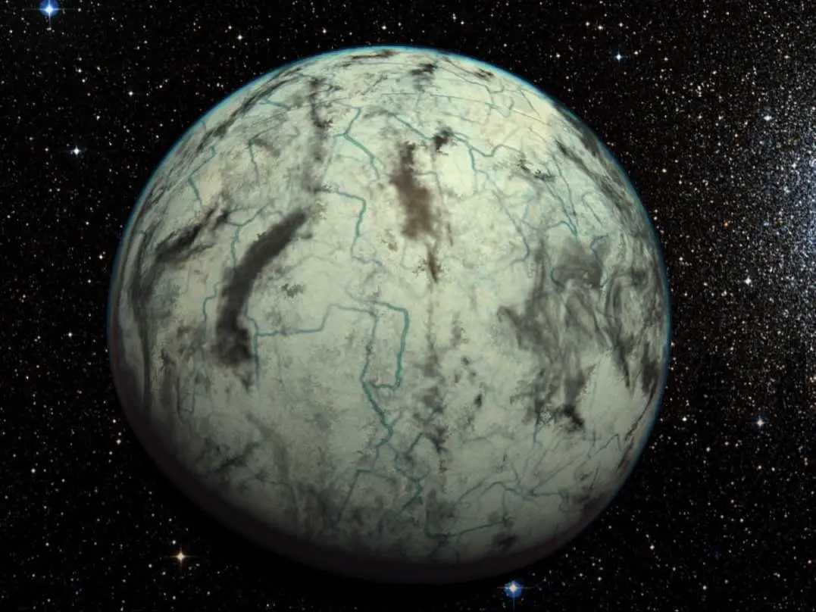
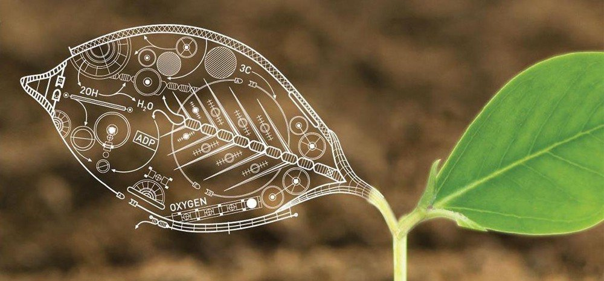
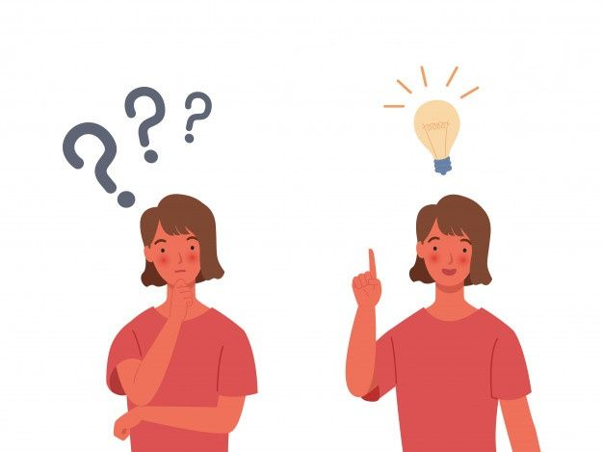

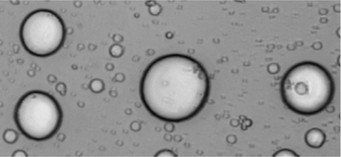
WHY BUILD SYNTHETIC CELLS?!
How does a natural cell function properly
How life might look on other planets
businessinsider.com.au
geneticliteracy project.org
Chem. Commun., 2015, 51, 11429-11432
How life on Earth originated
Addressing real-life problems
Clip-art credits: freesvg.org

Slide 21
Modules
What is life? Engineered products vs living organisms
Design Principle behind life
Construction of cells from basic biomolecules
Designing Cells to Obtain Desired Products
Applications of Synthetic Biology in Real Life Problem Solving
Our Project: CellOPHane

Slide 22
HOW CAN WE DESIGN CELLS FOR OUR PURPOSES?
Nikhita here

Slide 23
Building Blocks
Information on Design
Information on Production
Products of your design produced

Slide 24

Before we design, we must understand how cells produces molecules.
TRANSCRIPTION
TRANSLATION
DNA
RNA
Proteins
POLYMERISES
POLYMERISES
POLYMERISES
Nucleotides
Nucleotides
Amino acids

Slide 25
Workflow to produce a designer protein
Make a genetic construct
Insert that into a plasmid
Transform cells
Collect proteins produced by cells

Slide 26
Modules
What is life? Engineered products vs living organisms
Design Principle behind life
Construction of cells from basic biomolecules
Designing Cells to Obtain Desired Products
Applications of Synthetic Biology in Real Life Problem Solving
Our Project: CellOPHane

Slide 27
The ‘Big’ Problems....
Global Warming
Healthcare
Fuels and Energy
Pollution
Biodiversity
Water
Diagnostics
Waste Management
Food and Nutrition
Covid-19 (pandemics)
Pharmaceuticals

Slide 28
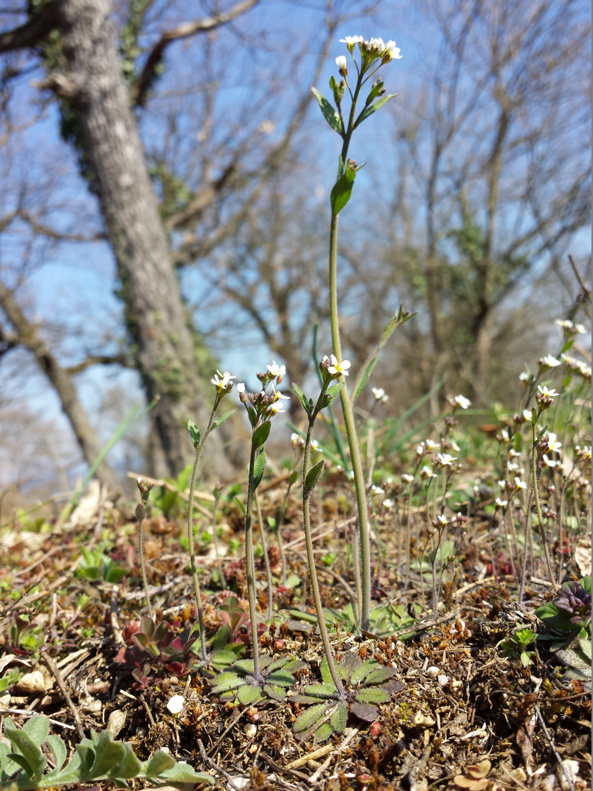
....The Small Solution!
There have been many Awesome developments that have occurred over the past decade with the use of synbio:
June Medford, Professor, Colorado State University, and her team engineered plants to purify salt water and secrete fresh water!
Ron Milo, Professor, Weizmann Institute and his team recently developed a strain of E. coli that can get all its carbon from CO2!
Bacteria that can remove methane from the atmosphere!
Source: Wikipedia

Slide 29
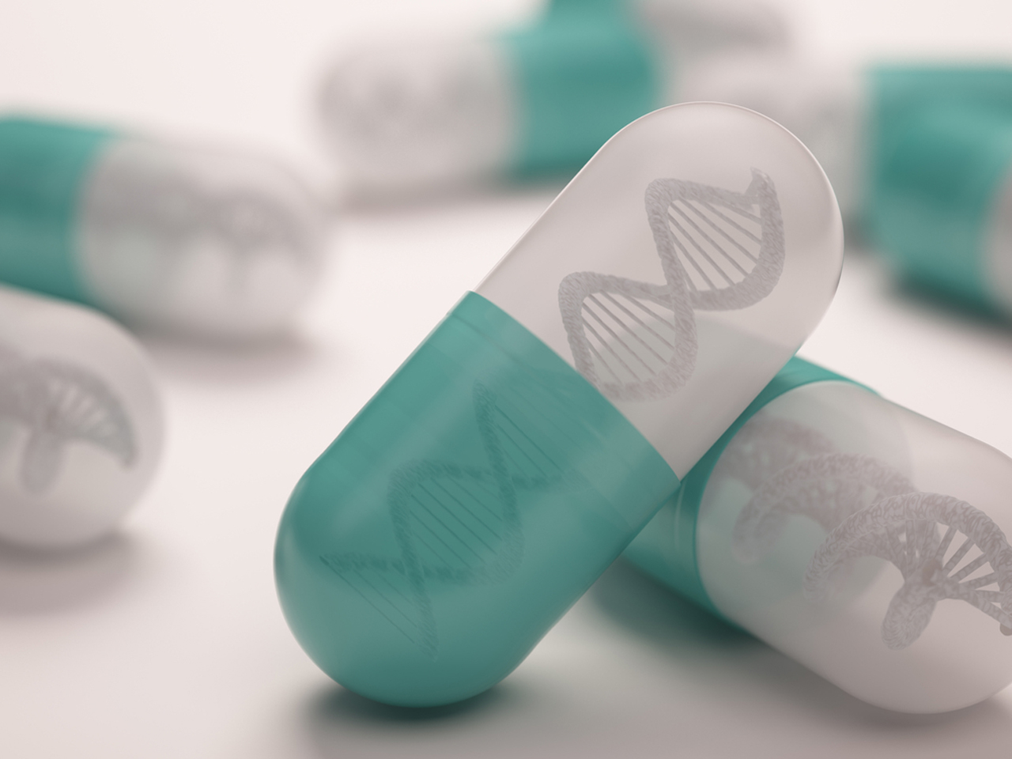

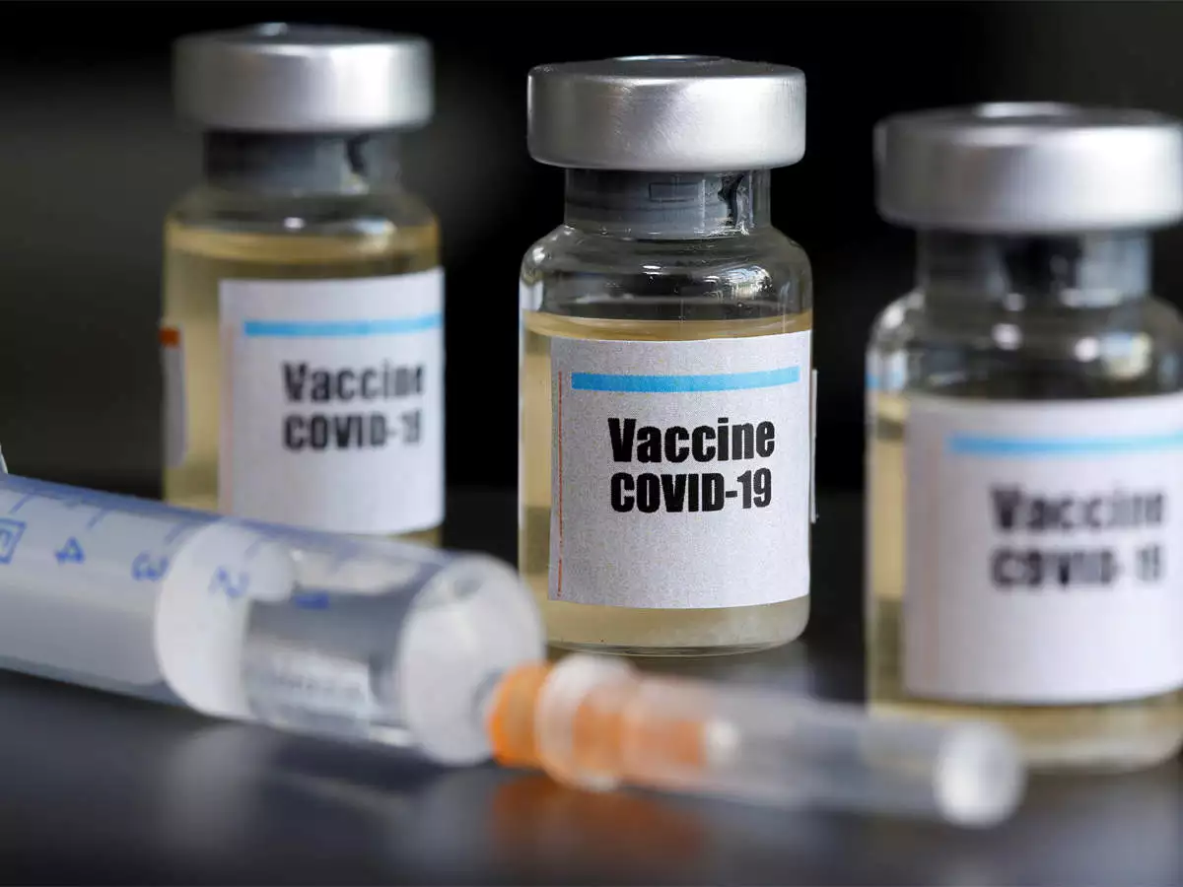
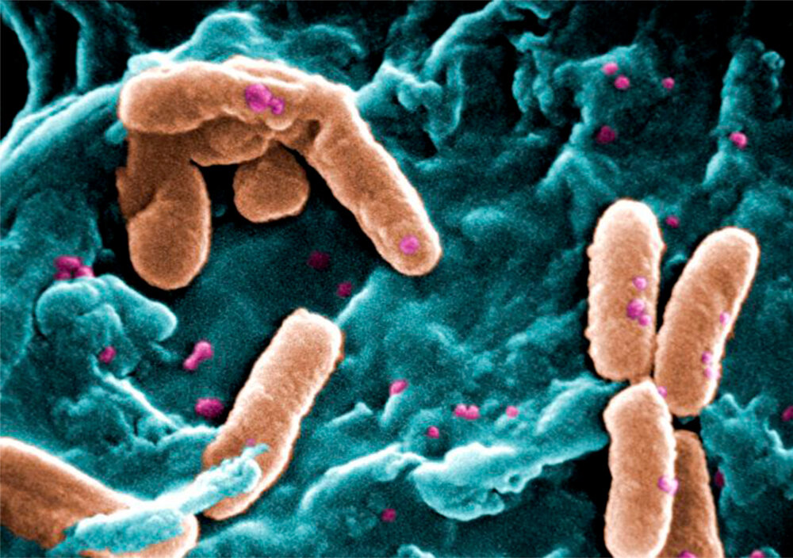
....The ‘Small’ Solution!
Personalised Medicine
COVID Vaccines
Restoring Extinct Species
Designer Babies (ETHICAL CONCERNS INVOLVED!!!)
Bioremediation :
Pseudomonas putida
And the list is endless....
Source: Infectious Diseases Hub
Source: Economic Times
Credits: Janice Haney Carr

Slide 30
Modules
What is life? Engineered products vs living organisms
Design Principle behind life
Construction of cells from basic biomolecules
Designing Cells to Obtain Desired Products
Applications of Synthetic Biology in Real Life Problem Solving
Our Project: CellOPHane

Slide 31
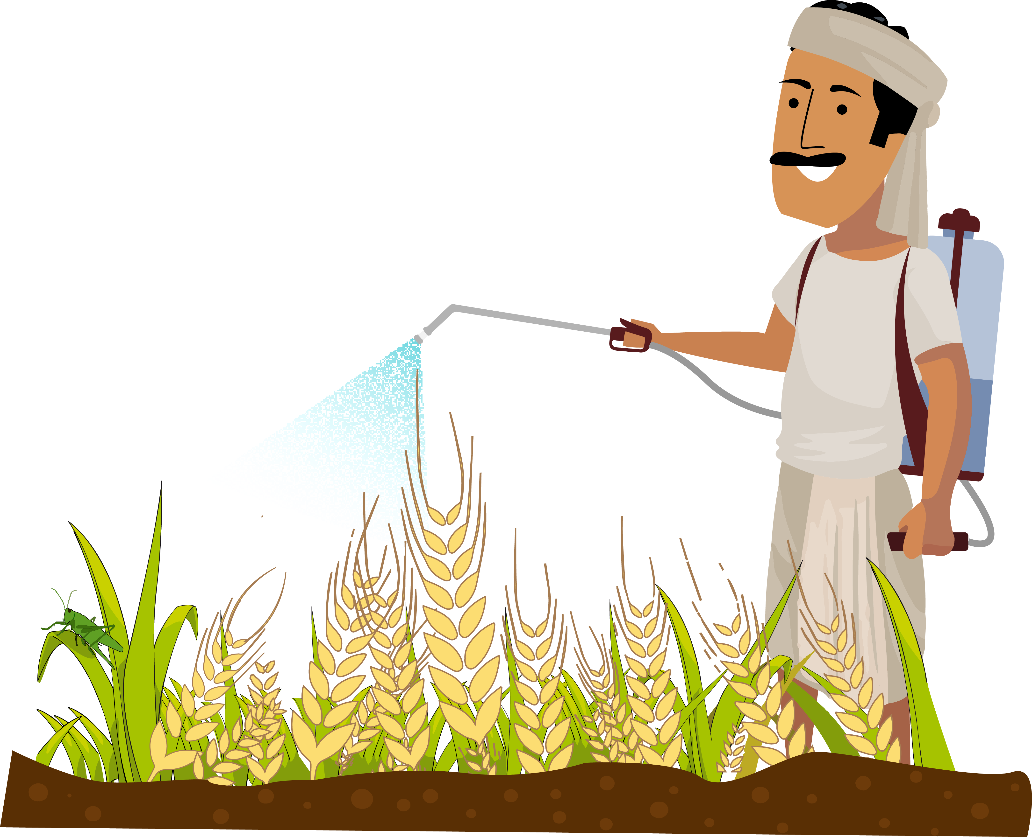
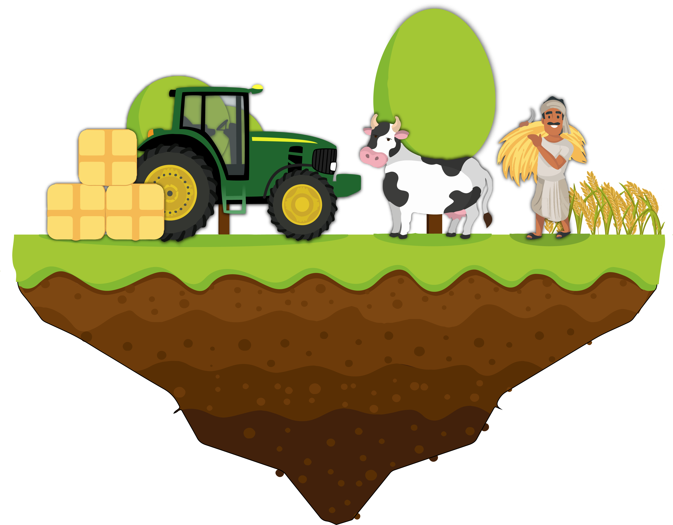
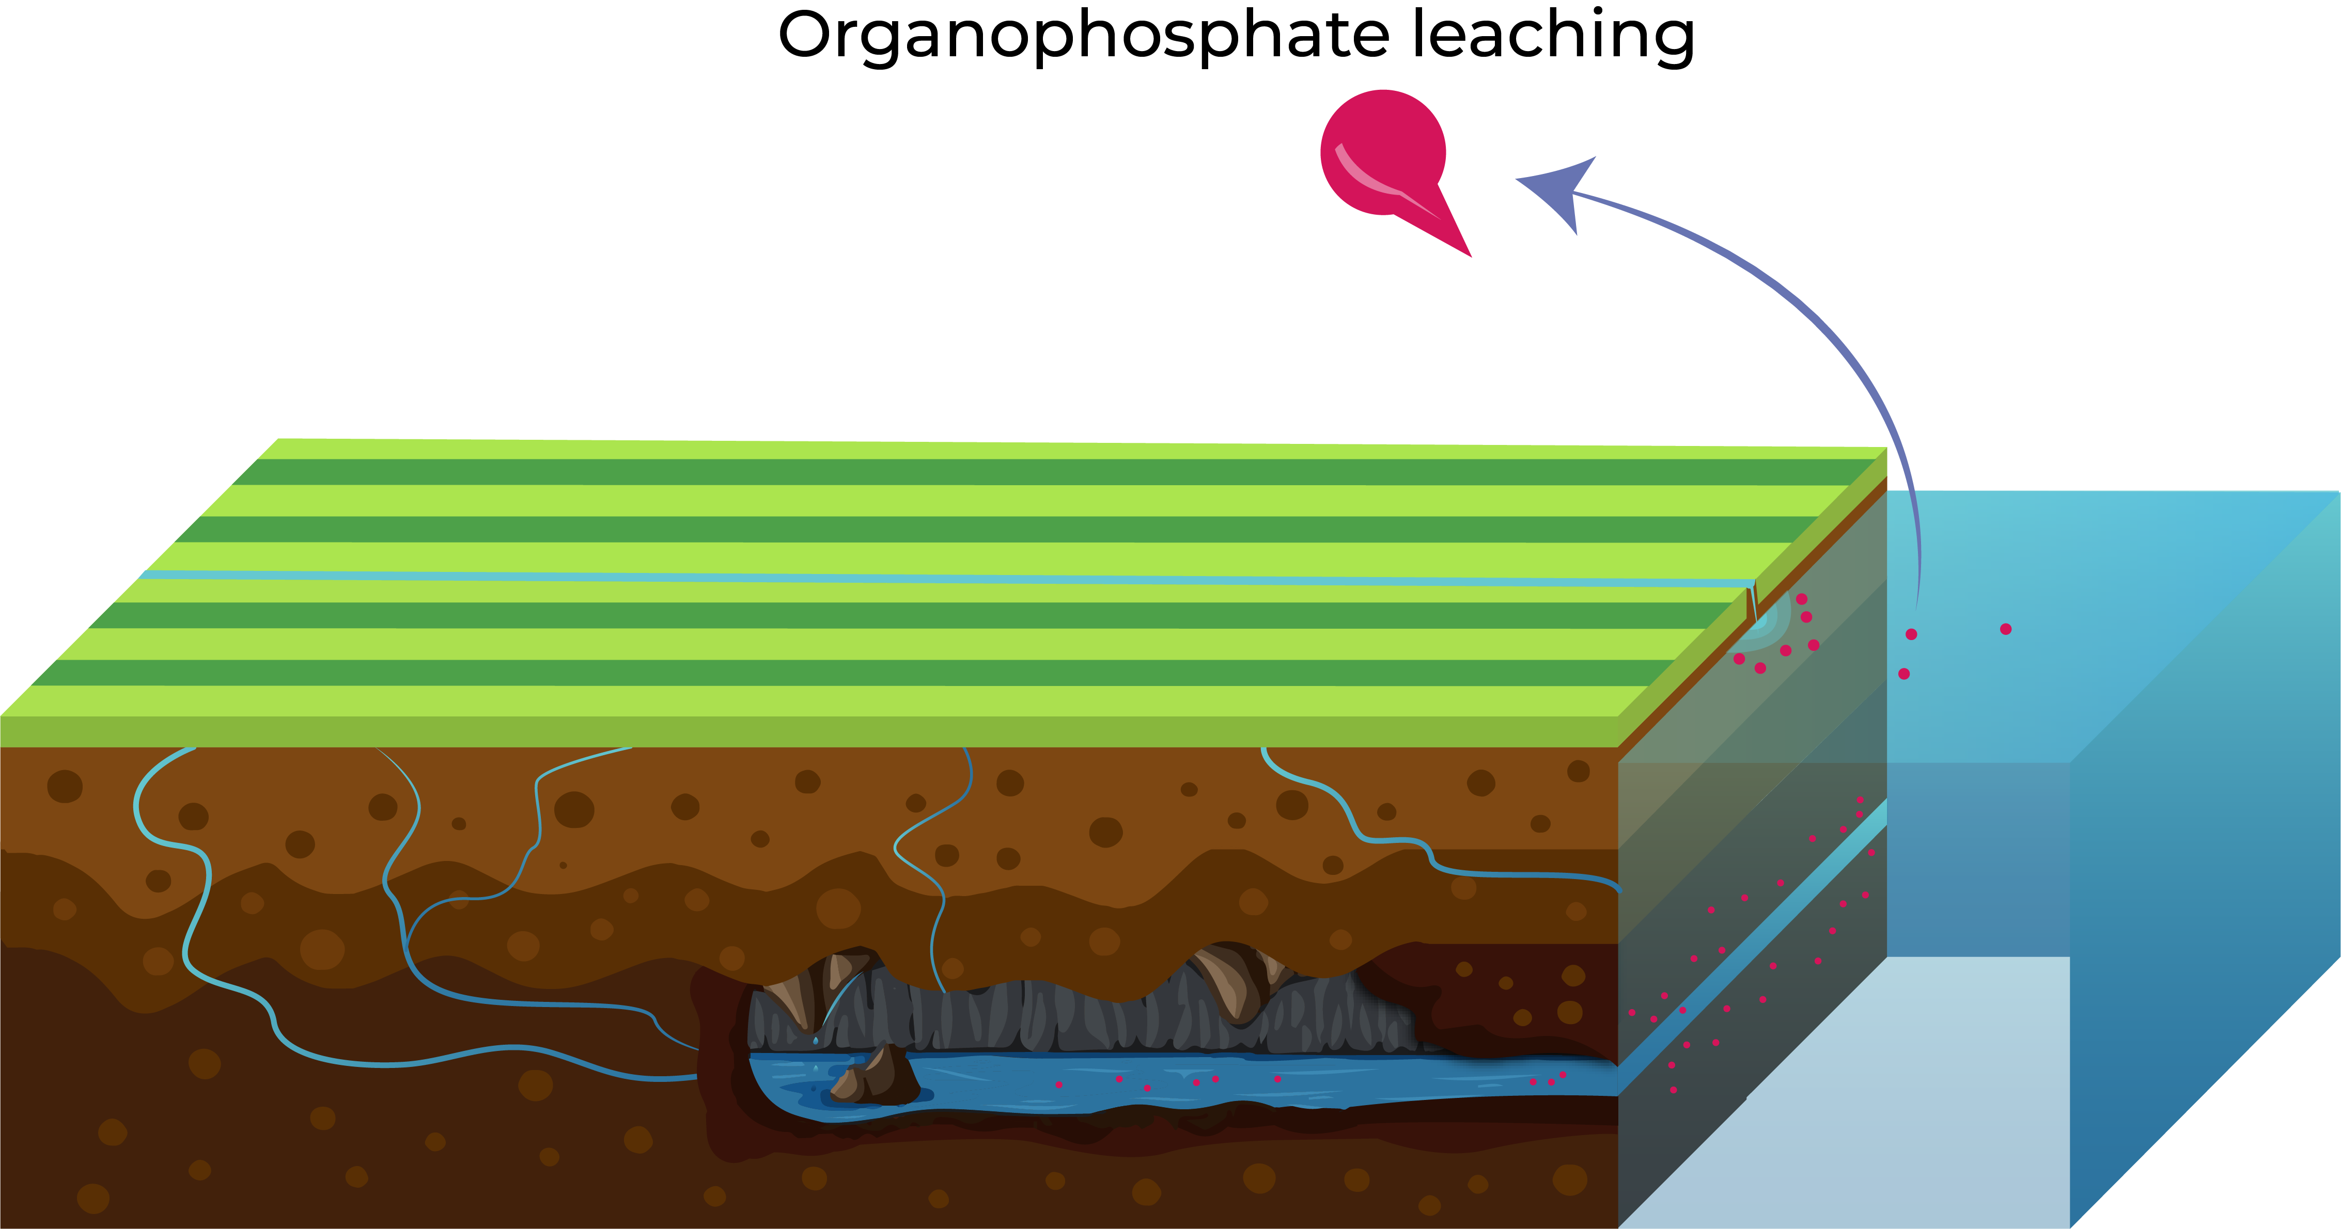
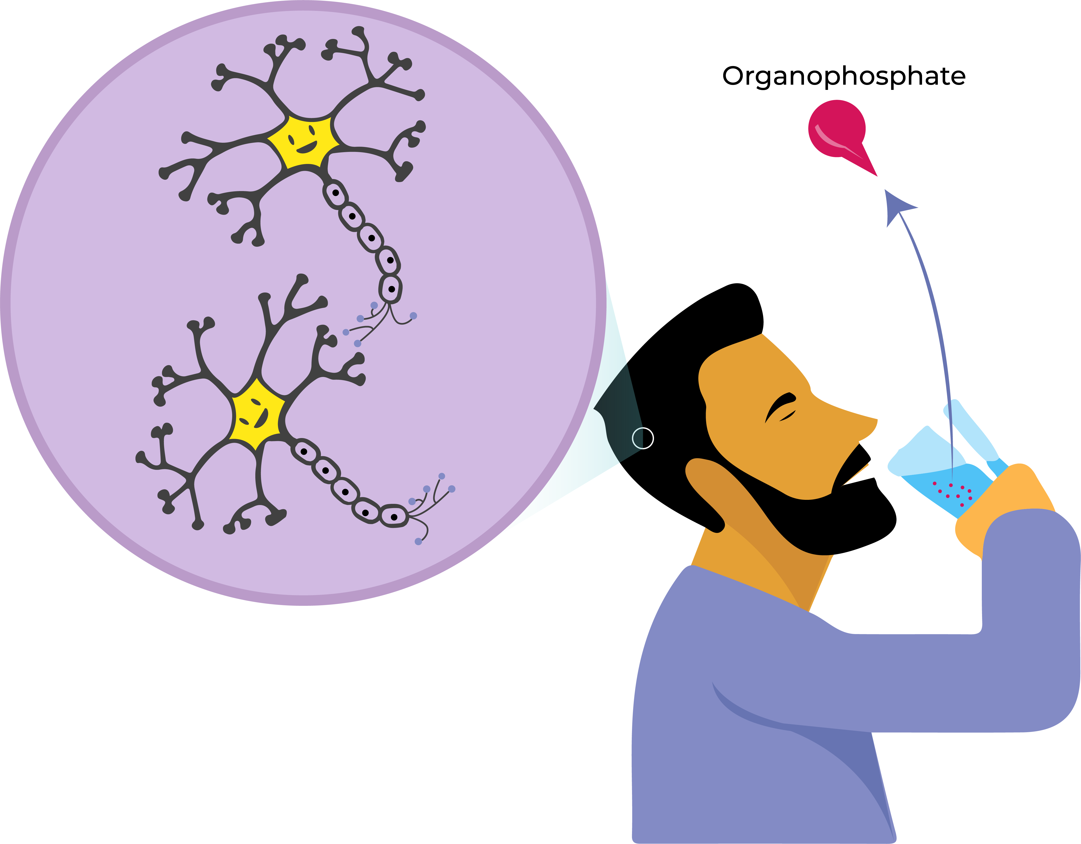
CellOPHane
Farmers spray pesticides to prevent their crops succumbing to pest attacks
About 50% of Indian population relies on agriculture as a source of livelihood
Organophosphates pesticides are widely used and these organophosphates can enter the run off water thereby contaminating the water source.
Organophosphate are neurotoxins and cause a plethora of health issues.
Acknowledgement: Aranya Dhibar

Slide 32
CellOPHane
A plug-n-play filter
Degrades organophosphates (used as pesticides) by using a broad-spectrum enzyme
Can be used for other similar bioremediation strategies with minimal modifications

Slide 33
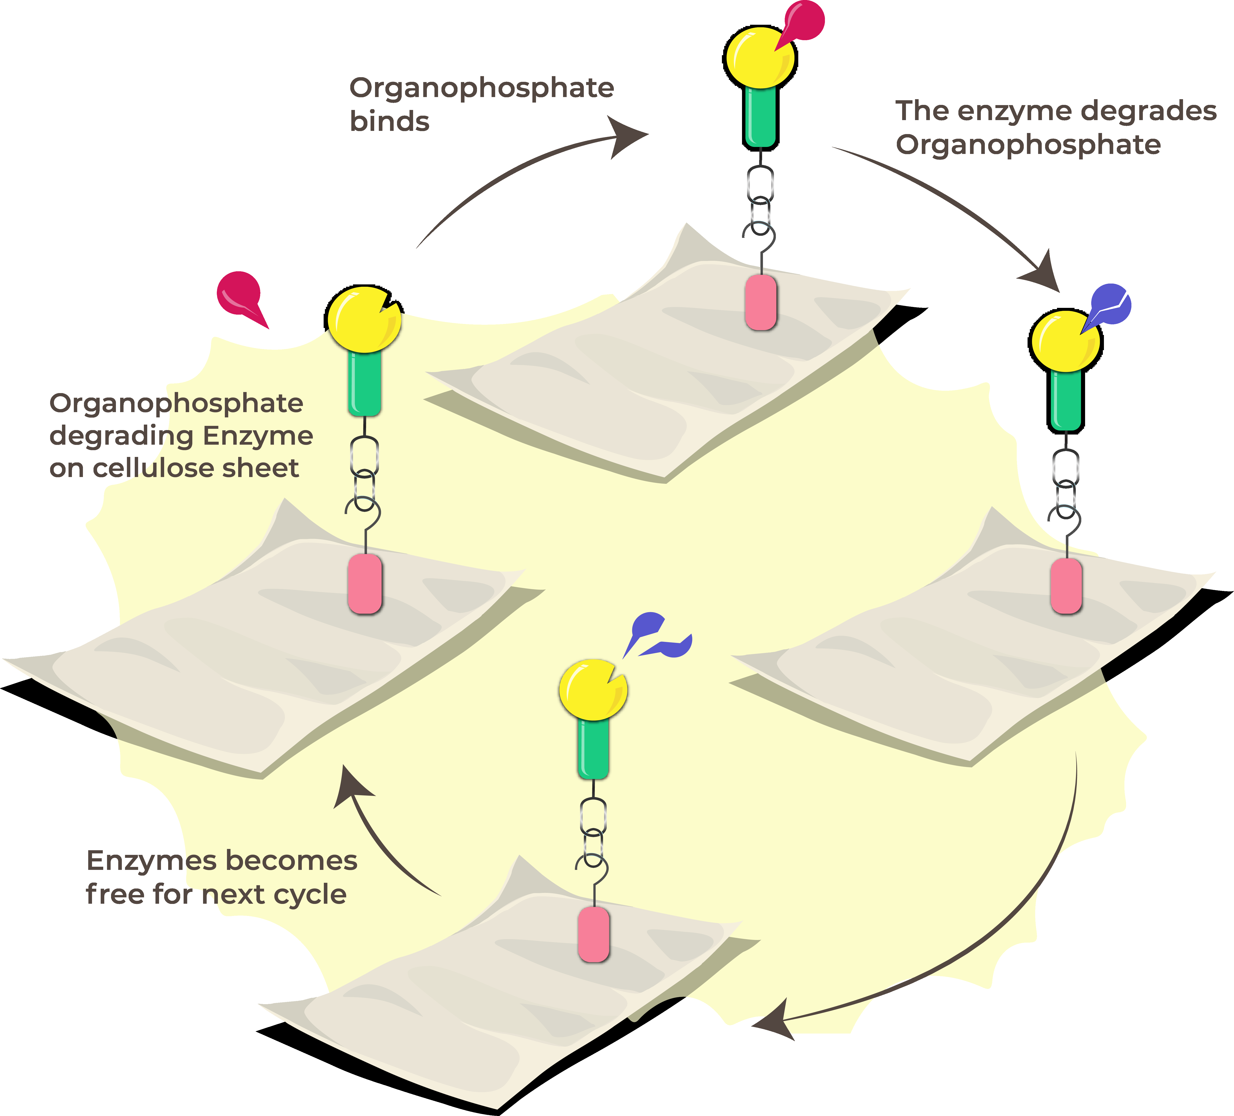
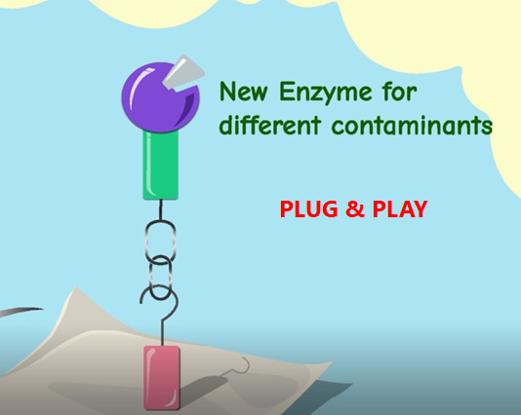
You can replace the organophosphate degrading enzyme to any other enzyme of your choice. The plug-and-play mode also this solution to be implemented in light of other bioremediation problems

